Slide 1
BIA Bookstore
GROUP – 5
Joao Pedro Goncalves Carazzato
Marcio Lisboa De Lima
Moksha Ramchetty
Siriwan Puyati

Slide 2
Project Overview
Developed a relational database system for a bookstore
Managed key data: customers, products, orders, vendors, deliveries
Applied ER modeling to define entities and relationships
Used normalization (1NF, 2NF, 3NF) to reduce redundancy
Implemented database using SQL with constraints for data integrity

Slide 3
Entities Identified
Strong & week entities
Customer
Product
Order
Vendor
Employee
Delivery
Cart, Order Details, Product Stock
Strong: Customer, Product, Order, Vendor, Employee
Weak: Cart, Order Details, Delivery, Product Stock, Vendor Orders
Weak entities depend on parent tables

Slide 4
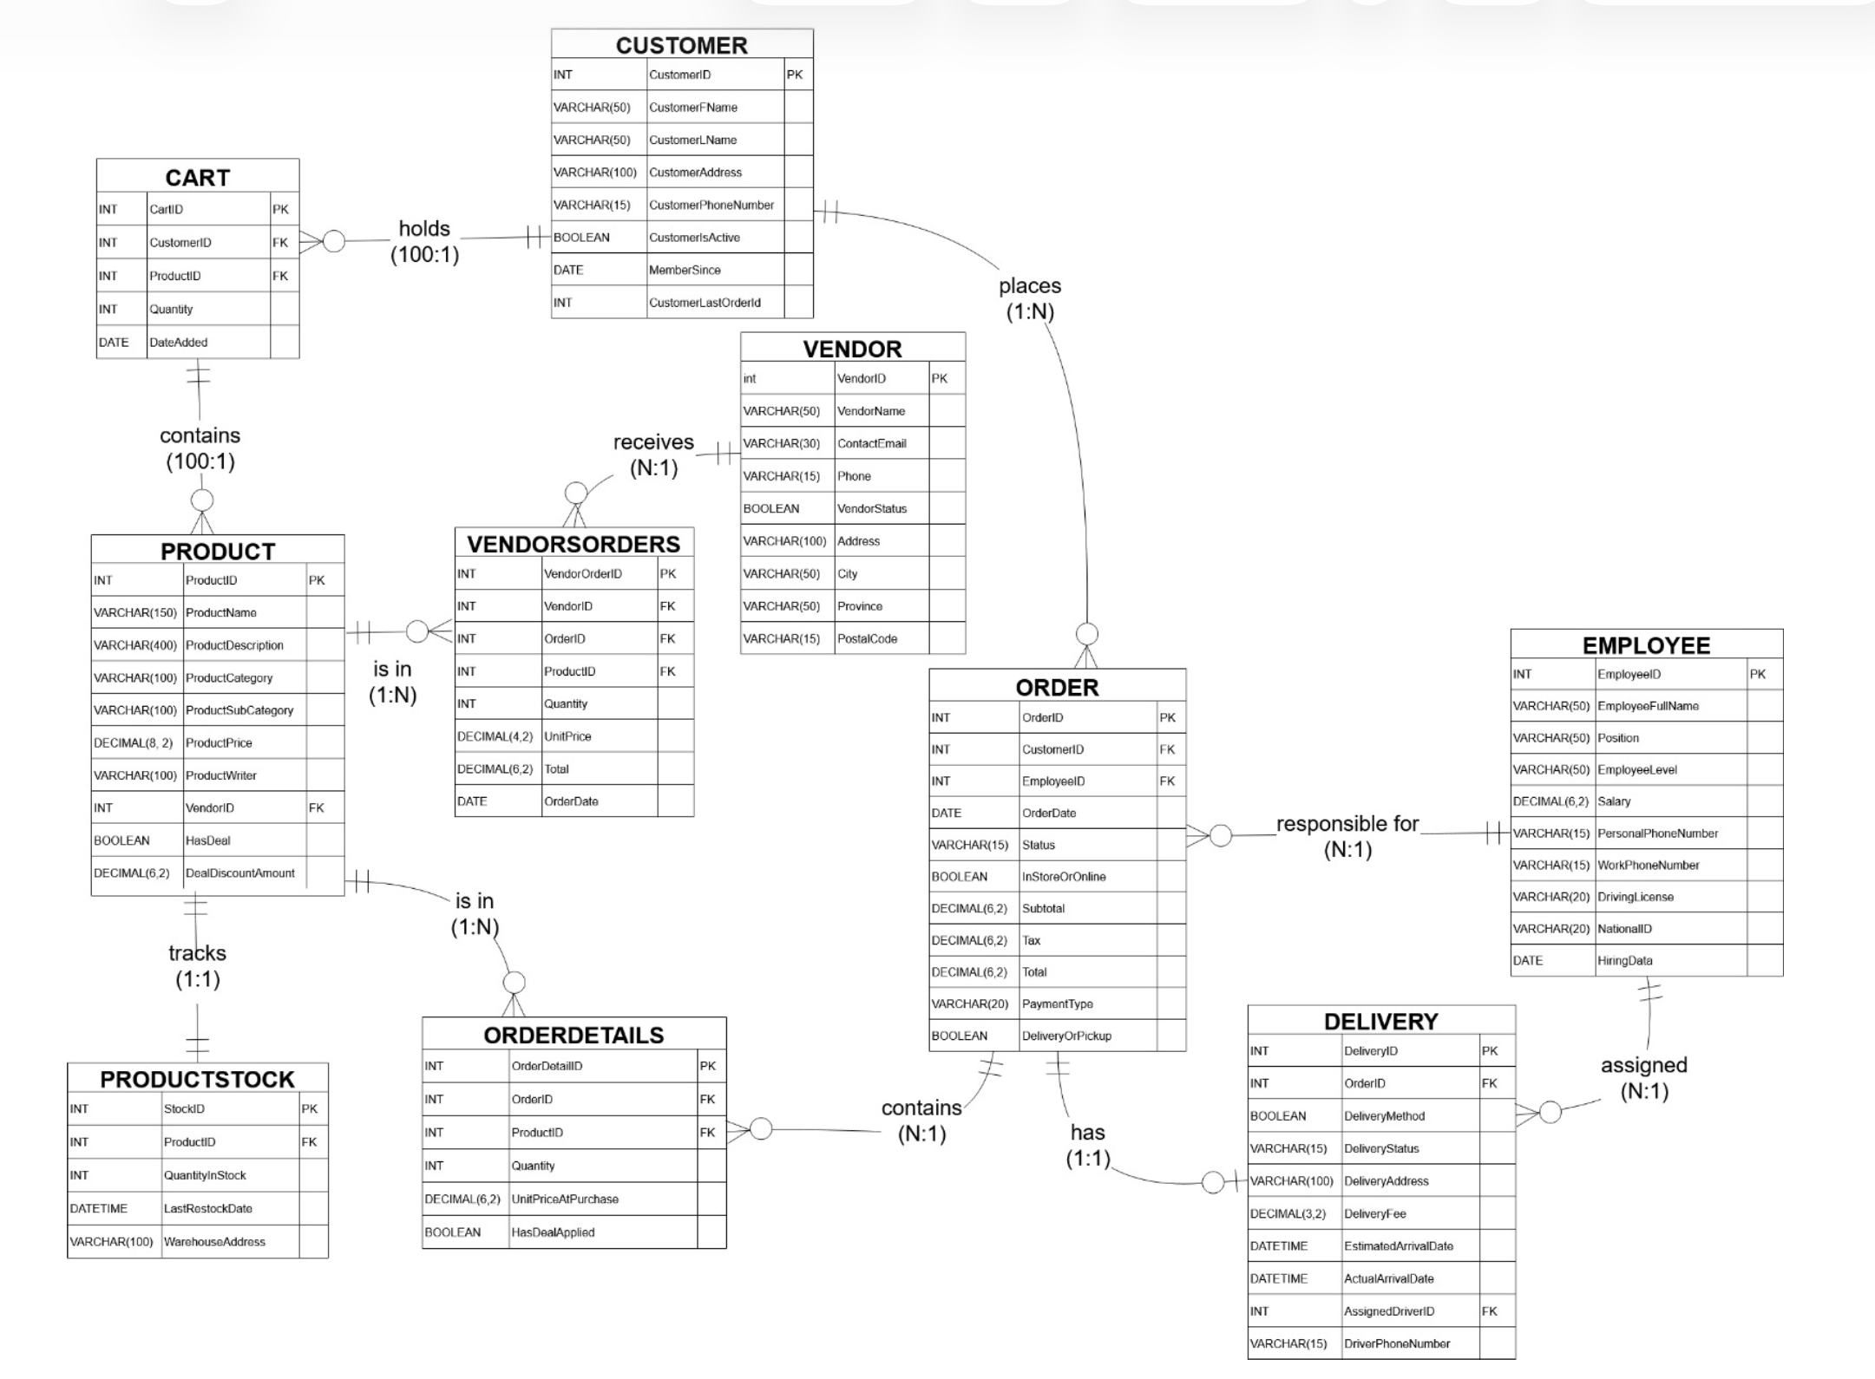
ERD

Slide 5
Normaliztion Process (1NF, 2NF, 3NF)
1NF: Removed repeating groups → each product stored in separate rows, split customer details into atomic attributes
2NF: Removed partial dependencies → separated data into tables like Product, Orders, and Orde Details
3NF: Removed transitive dependencies → moved customer, employee, and vendor data into separate tables
Converted unstructured data into well-organized relational tables
Reduced redundancy and improved data consistency

Slide 6
Final Tables Created
Customer
Employee
Vendor
Product
Orders
Order Details
Delivery
Cart
Product Stock
Vendor Order

Slide 7
SQL Implementation

Slide 8
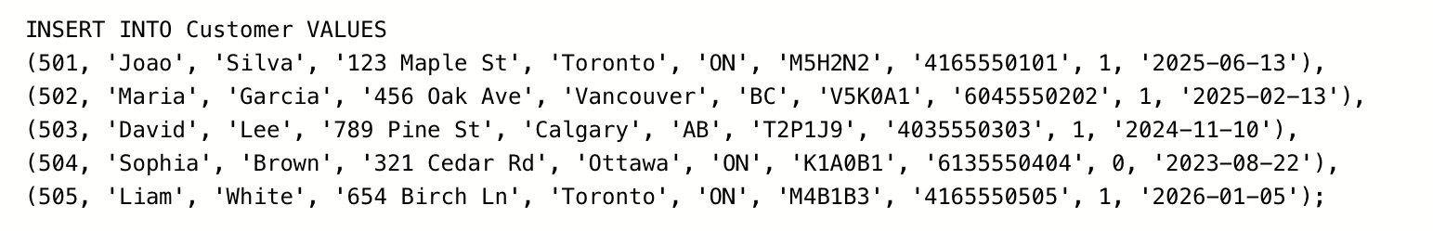
Table Creation
Xxxx

Slide 9
Data Insertion
Inserted sample data using SQL
Verified using SELECT queries

Slide 10
Data Integrity and Business Rules (Advanced DDL)
Technical Focus: Ensuring data consistency through constraints.
Key Points:
Foreign Keys: Implementation of ON UPDATE CASCADE and ON DELETE CASCADE for automated data synchronization;
CHECK Constraints: Logic-based rules like CHECK (QtyInStock >= 0) to prevent business errors such as negative inventory;
Data Validation: Using NOT NULL and PRIMARY KEY to guarantee every record is unique and complete.

Slide 11
Dynamic Data Manipulation (DML)
Technical Focus: Demonstrating real-time database updates.
Key Points:
Data Insertion: Efficiently adding new customers to the growing database;
Price Management: Updating product prices (e.g., adjusting Product 'P01' to 48.00) for promotions;
Inventory Cleanup: Removing expired cart items or cancelled orders using the DELETE command.

Slide 12
Business Intelligence & Reporting (DQL)
Technical Focus: Extracting insights using Joins and Aggregations
Key Points:
Sales Performance: Calculating total revenue by order status using GROUP BY and SUM;
Customer Loyalty: Identifying "VIP" customers with multiple orders via HAVING COUNT;
Logistics Tracking: Linking deliveries to specific drivers using INNER JOIN across three tables.

Slide 13
Mission-Critical Security (TCL)
Technical Focus: Transaction Management (Commit & Rollback)
Workflow:
TRANSACTION START: Safely beginning a series of operations;
COMMIT: Permanently saving changes once verified;
ROLLBACK: Instantly undoing changes if an error occurs to prevent data corruption.

Slide 14
Practical Demonstration
Theme: SQL Server Management Studio (SSMS) and MYSQL in Action
Visual: (Placeholder for a screenshot of your SQL code running)
Action: Transition from the slides to your live code environment.

Slide 15
SQL Project Conclusion
Theme: Project Outcomes and Key Learnings
Key Achievements:
  Successful Normalization: Converted unstructured data into a 3NF relational database to eliminate redundancy.
  Operational Readiness: Implemented a system capable of managing the full lifecycle of a bookstore, from Vendors to Deliveries.
  Data Integrity: Applied PK, FK, and check constraints to ensure a robust and reliable system.
  Advanced Logic: Showing the ability to handle complex business questions and secure transactions via SQL.

